Slide 1
Making Square Logos for your Exhibitor Booth
TPO Show 2021

Slide 2
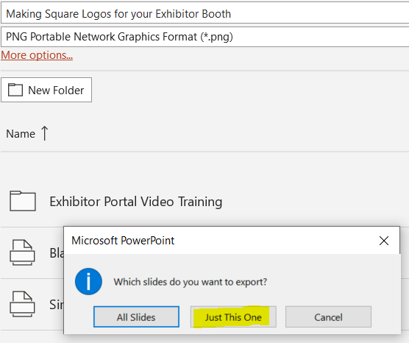
Instructions
Select a black background or white background slide in this deck
Or you can make a large 9” by 9” square in the color of your choice on a new slide
Place your logo on the slide
Use Arrange > Align > and use Align Center then Align Middle to center your logo on the slide
Do File > Save As and choose .png or .jpg, click SAVE, and choose “just this one.”
Save the square image somewhere you can get to it
Open the image in a graphics program
Resize to 300x300 pixels

