Slide 1
Making Banners (936h x 160w) for your Exhibitor Booth
TPO Show 2021

Slide 2
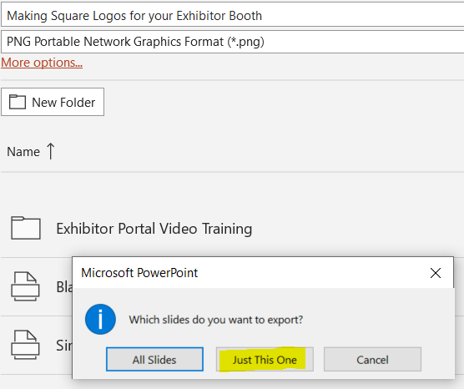
Select a black background or white background slide in this deck
Or you can make a 9.75 inch wide by 1.67 inch high rectangle in the color of your choice on a new slide
Place your logo on the slide
Use Arrange > Align > and use Align Center then Align Middle to center your logo on the slide
Do File > Save As and choose .png or .jpg, click SAVE, and choose “just this one.”
Save the square image somewhere you can get to it
Open the image in a graphics program
Resize to 926x160 pixels

