Slide 1
Higher Ed Office Hours
Fall Reunion Events/Homecoming

Slide 2
Agenda
1
Introductions
2
Breakout Rooms
3
Main Takeaway / Question & Answer
4
Wrap Up

Slide 3
Introductions
Name
Organization and Title
What are you looking to get out of this session today?
What is your favorite fall activity?

Slide 4
Breakout Rooms
What is your largest event this fall?
What is your greatest challenge with hosting those events?
What does your team do to overcome them?
How do you measure attendee engagement at these events?
What deems your event as successful?

Slide 5
Notes:
This year, we are launching Community User Groups, giving you a place to connect and learn with industry professionals and Cvent users, just like you. These are customer driven groups that provide a collaborative space for networking, thought leadership, knowledge swapping, and maximizing Cvent usage. The user groups will give you the space to connect how you want to and on the topics that are most important to you. If you’re interested in leading one of these groups, we’ll soon have resources that help you do so. We’re planning the first sessions now, so keep an eye on the Community for updates!
Community Page: https://community.cvent.com/user-groups

Slide 6
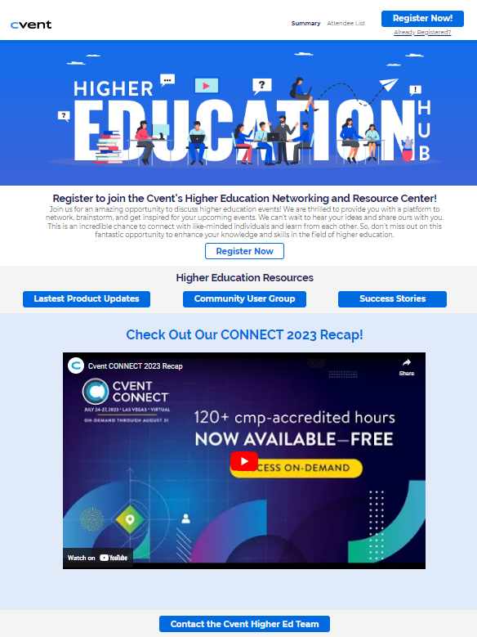
Higher Education Hub
Join us for an amazing opportunity to discuss higher education events! We are thrilled to provide you with a platform to network, brainstorm, and get inspired for your upcoming events. We can't wait to hear your ideas and share ours with you. This is an incredible chance to connect with like-minded individuals and learn from each other. So, don't miss out on this fantastic opportunity to enhance your knowledge and skills in the field of higher education.
Network with peers and colleagues
Discuss best practices
Brainstorm Ideas
REGISTER HERE
Next Session: December 5th 2PM EST
Notes:
Have you checked out our new product learning centers in the Cvent Community? If you click into Education, you will see a new option for learning centers, segmented by product. Each learning center is a centralized hub of resources for each Cvent solution.

Slide 7
Next Steps
Fill out the Feedback Survey
Join the Higher Ed Community User Group
Mark your calendars for December 5th for our next huddle!

